Slide 1
EECS 498 System Design of a Search Engine
Winter 2025
Lecture 3: Project planning
Nicole Hamilton
https://web.eecs.umich.edu/~nham/
nham@umich.edu

Slide 2
agenda
Course details.
Result quality.
Your project.
Project planning.

Slide 3
agenda
Course details.
Result quality (that we didn’t get to last time.)
Your project.
Project planning.

Slide 4
details
Really hoping everyone can find a team by this weekend.
Tell me the name of your team and your teammates by Sunday January 18, 11:59 pm.
Submit a group photo by Sunday January 25, 11:59 pm.
If you are joining late, I’ll give you extensions to catch up on the previous assignments.
A final comment on MostPositiveSubsequence perf.
Mascot suggesions.

Slide 5
int ImprovedBenchmark( int a[ ], int n, int &bestL, int &bestR )
{
assert( n );
int sum, bestSum, L, R;
bestSum = a[ 0 ];
bestL = bestR = 0;
for ( L = R = sum = 0; R < n; )
{
sum += a[ R ];
if ( sum > bestSum ||
sum == bestSum && R - L < bestR - bestL )
{
bestL = L;
bestR = R;
bestSum = sum;
}
R++;
if ( sum <= 0 )
{
sum = 0;
L = R;
}
}
return bestSum;
}
Can this be improved with
local variables?
Student ticks = 240777
Benchmark ticks = 304328
Ratio = 0.791176
Perf limit = 1.1
Performance is okay
Test succeeded

Slide 6
int ImprovedLocals( int a[ ], int n, int &bestL, int &bestR )
{
assert( n );
int sum, bestSum, L, R, bL, bR;
bestSum = a[ 0 ];
bL = bR = 0;
for ( L = R = sum = 0; R < n; )
{
sum += a[ R ];
if ( sum > bestSum ||
sum == bestSum && R - L < bR - bL )
{
bL = L;
bR = R;
bestSum = sum;
}
R++;
if ( sum <= 0 )
{
sum = 0;
L = R;
}
}
bestL = bL;
bestR = bR;
return bestSum;
}
It’s not faster.
Student ticks = 303140
Benchmark ticks = 295698
Ratio = 1.02517
Perf limit = 1.1
Performance is okay
Test succeeded

Slide 7
homework
This weekend’s Gantt chart assignment asks you to create a plan to apply to graduate school. Yes, I have an agenda.
This is your last individual homework assignment other than voting on stuff.

Slide 8
We need a cartoon mascot for a class tee shirt. What animal should it be?
The -121 Section
Burmese Rescue Dog
Fat Squirrel
Eagle
C++ Mascot (a Rat)
Hawk
Spider
Lady bug
Octopus
The -051 Section
Road Runner
Panda
Cute spider
Raccoon
Owl
Cheetah
Mole peeking out of a hole
Golden retriever
We’ll turn this into a survey. Let you pick your top 3. Perhaps a runoff if we don’t have a clear winner.

Slide 9
agenda
Course details.
Result quality.
Your project.
Project planning.

Slide 10
result quality
To be useful as a search engine, it must produce good results quickly.

Slide 11
result quality
Traditional measures:
Precision The fraction of the results that are relevant.
Recall The fraction of all relevant results returned.

Slide 12
result quality
And because it matters that the top results be the best:
Relevance An estimate of the overall quality of the page as an result for this query that can be used for ranking (ordering) the results.

Slide 13
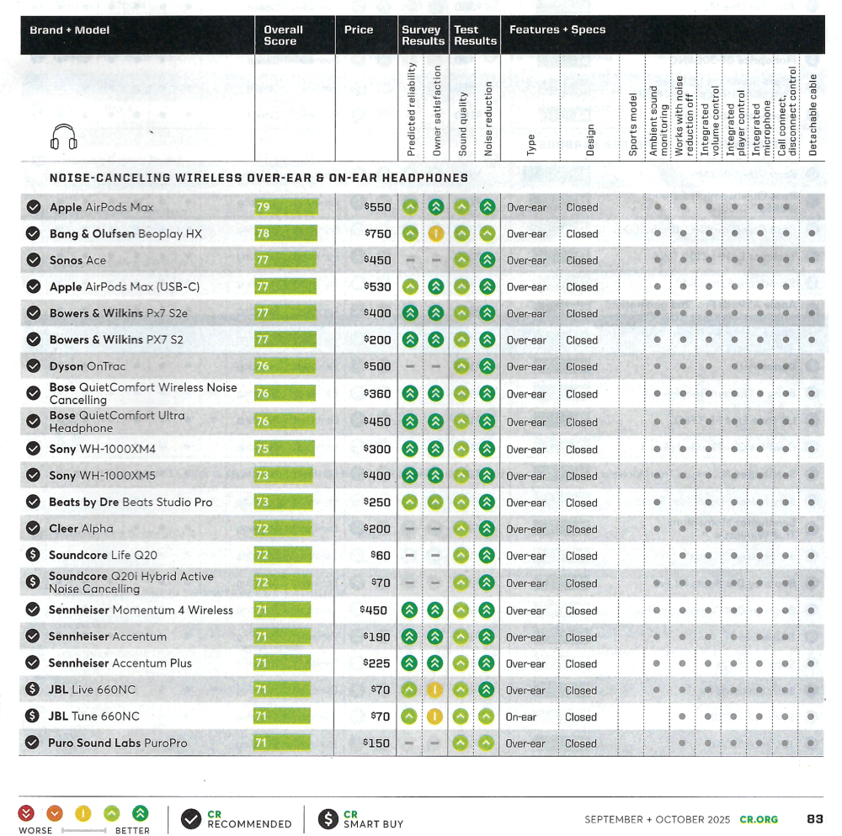
ranking: pick the best

Slide 14
kinds of rank
Dynamic rank How good a match this page is to this specific query.
Static rank How good the page is, knowing nothing about the query.

Slide 15
static rank
Some pages are just better than others before you know anything about the query.

Slide 16
static rank
Some domains are better than others, e.g., .gov or .edu over .biz.
Short URLs are better.
Short titles are probably better.
Some pages may be obvious spam.
Some pages may have lots of other pages pointing to them, e.g., PageRank.

Slide 17
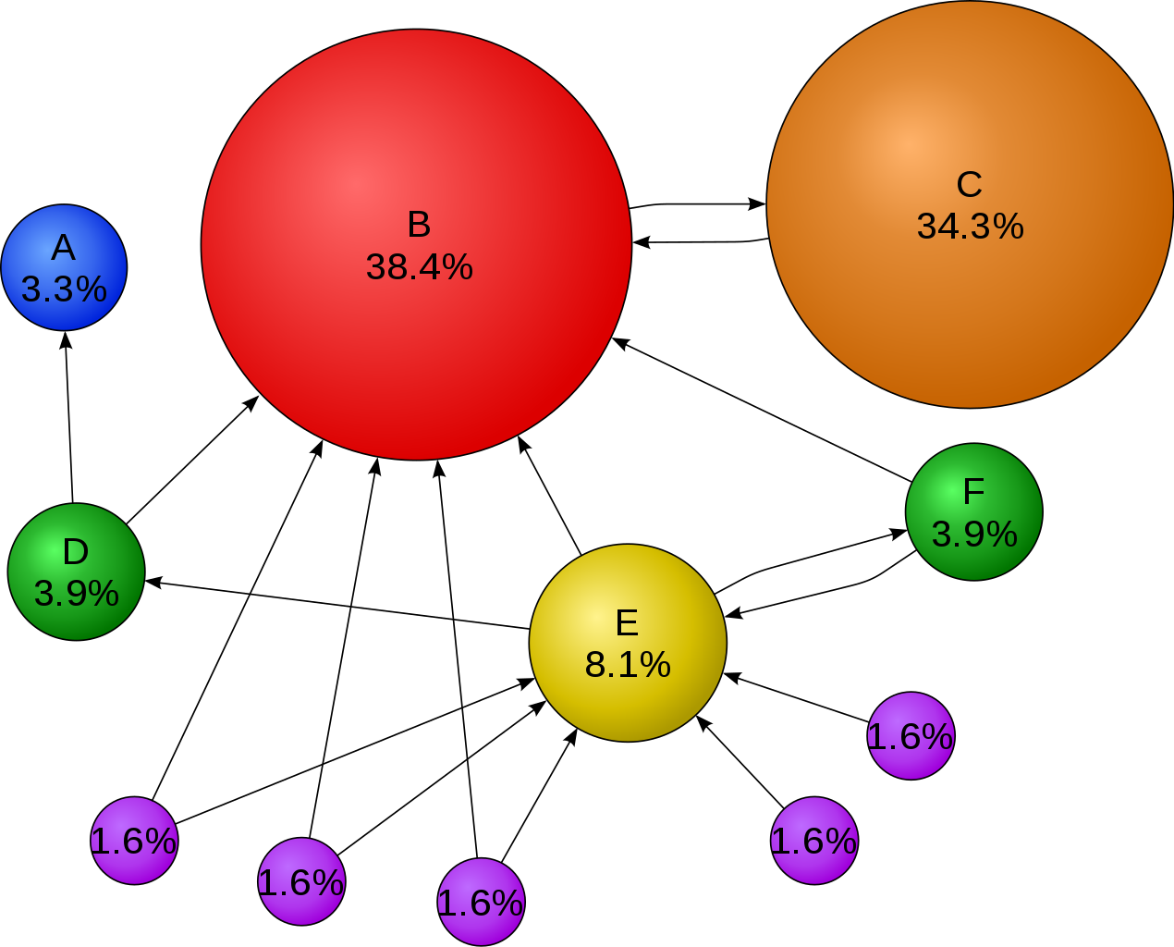
PageRank
The basic idea: The more and better links to a page, the more likely it should rank higher.
Image source: https://upload.wikimedia.org/wikipedia/commons/thumb/f/fb/PageRanks-Example.svg/1270px-PageRanks-Example.svg.png

Slide 18
PageRank
It obviously did work and they got better results.
It also gave halo of special legitimacy to their results, that they were scientific and unbiased.

Slide 19
at Microsoft
We gamely expected our version of PageRank to represent about half the overall rank value, largely based on the hype around it.
Turned out it was very expensive to calculate and represented only a small part of the final rank score.

Slide 20
dynamic rank
Estimate the quality of match between the page and the query.
Traditional methods in information retrieval considered the page as a bag of words and ostensibly measured the mathematical or statistical similarity.
For example, one method claimed to consider the document and the query as vectors and to calculate the angle between them.

Slide 21
bag of words
A scoring method that considers only that the search words occur in the document, not where or in what relation to each other.

Slide 22
tf-idf
Term-frequency, inverse document frequency.
Easily the most famous bag of words technique. The more occurrences of a rare word, the better.
Problem is, it doesn’t work on the web.

Slide 23
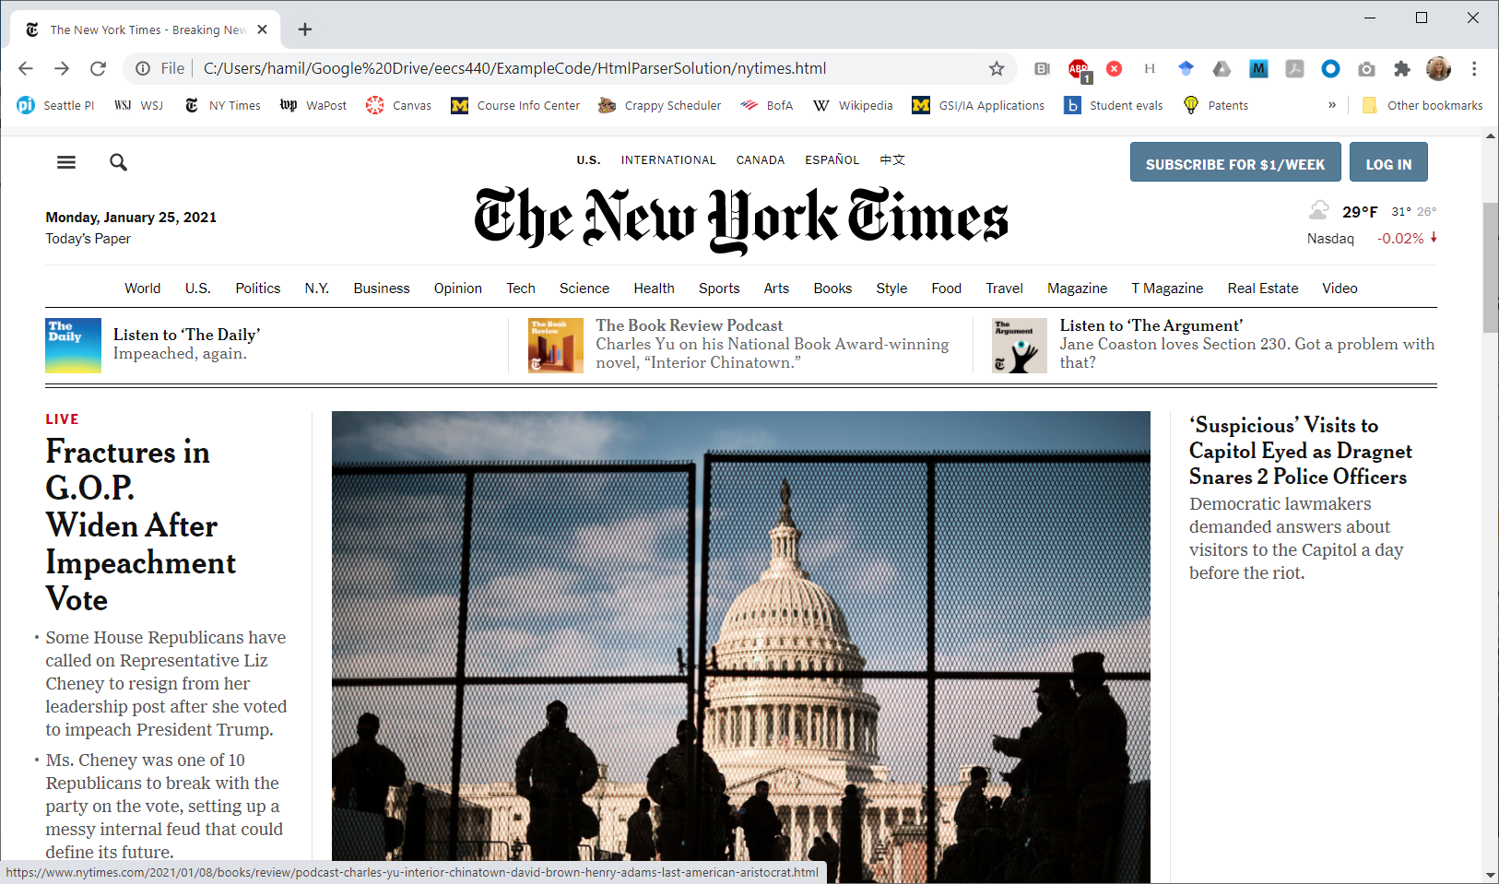
bag of words
Here’s a sample NY Times page from Jan 25, 2021.

Slide 24
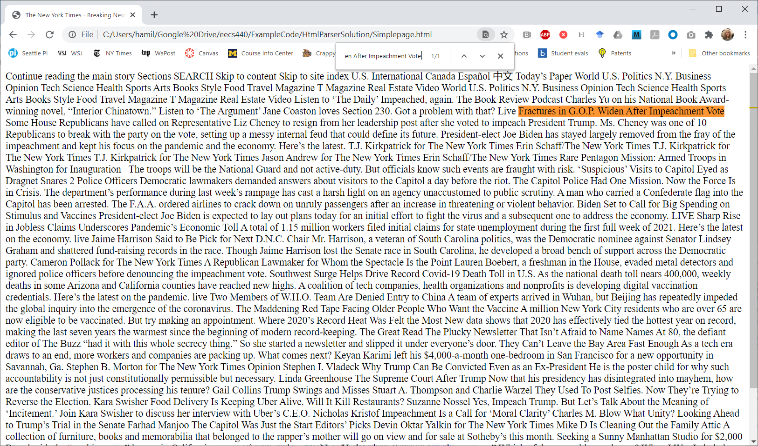
bag of words
Here it is stripped of HTML and CSS but the text remains.

Slide 25
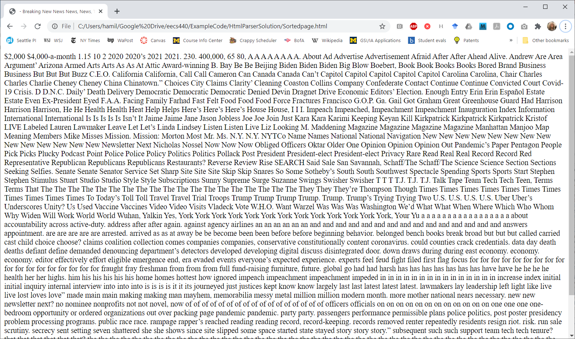
bag of words
Here it is with the words in the title and body sorted. Tf-idf can’t tell the difference.

Slide 26
at Microsoft
At Microsoft, we separated the occurrences into four metastreams, in order of importance.
Anchor text.
URL.
Title.
Body text.

Slide 27
heuristics
Pick the rarest word in the query, then iterate over its occurrences on the page.
At each place, move the pointers to the other words to as close to the correct relative position as possible.
Score that that set, called a span, counting the number of spans, the number of exact phrases, in order, close together, etc.
Score the counts, weighting exact phrases the title as more important than other matches.

Slide 28
heuristics
Altogether, had about 700 heuristics in a linear combination.
Tuned them using gradient descent and approximately 150K labeled pages and queries.
But W25, several teams got great results hand-tuning with only about 12 to 20 heuristics using this algorithm.

Slide 29
what we found
Finding the search words in the right order and close together was more important than simply finding lots of them.
Added tf-idf because under pressure that of course we should consider it. Removed it because it added nothing to our relevance but slowed our crawl.
It mattered a lot where we found the matching terms.
Anchor > URL > Title > Body text

Slide 30
agenda
Course details.
Result quality.
Your project.
Project planning.

Slide 31
overall plan
Get you crawling ASAP on your laptops.
Cover the OS topics you’ll need.
Explain how each piece works just in time for you to build it, starting with the crawler.
Get your engines working on the cloud.

Slide 32
Your project
I’ve broken your engines into 9 slightly arbitrary levels of functionality:
0 Basic plan for your project.
Parse text files into a hash table.
Build a crawler.
Build a reverse word index.
Create a user interface.
Build a constraint solver and query parser.
Build a ranker.
Deploy on the cloud.
Advanced functionality.

Slide 33
level 0: create a plan
Decide what information you’ll collect.
Decide whether to keep a copy of every document you crawl and index.
Estimate the required storage and when will you need it.
Break the problem down into pieces. Decide (guess!) what each piece does, how it works, and the LOC required.
Decide how you’ll work as a team, meetings, source control, common libraries, etc.
Prepare a written plan (which you will submit) with deliverables, milestones, responsibilities, and a schedule.

Slide 34
level 1: parse text files into a hash table
Parse text files into tokens, stripping out most HTML but identifying links and anchor text.
Create a hash table as a memory-mapped index on disk of the parsed content.
Given a search word, list the occurrences by searching the index.

Slide 35
level 2: build a crawler
Given a list of URLs, retrieve the documents by HTTP and HTTPS, following redirects.
Create a crawler to manage a frontier of URLs to be explored, eliminating URLs already seen.
Ensure it can be restarted.
Decide what makes one URL better than another. Be polite.
Define a seed list to start crawling.
Parallelize the tasks of crawling, parsing and index build.

Slide 36
level 3: build a reverse word index
Define a file format. Decide how you will merge multiple index files.
Decide how you will structure and encode your data.
Decide how to number locations across documents. Accumulate useful statistics.
Demonstrate you can build the index.
Demonstrate you read the index.
Create index stream readers for words and documents.

Slide 37
level 4: create a user interface
Initially, a simple command line interface.
Later, a simple HTTP server to act as a wrapper UI.
Allow the user to enter a query and get a response.
Report title, clickable URL, possibly other interesting information for matching pages.

Slide 38
level 5: constraint solver and query parser
Create a basic index stream reader for an individual words and document boundaries.
Create derived stream readers for AND, OR, phrase and NOT.
Build a top-down recursive descent parser to compile queries into index stream readers.
Demonstrate the ability to find the next document matching a query.

Slide 39
level 6: build a ranker
Hopefully, something better than a bag-of-words technique.
Rank using static attributes of the page, e.g., length of the URL, number of words on the page, length of the title.
Rank using heuristics or other means that consider the quality of match, e.g., exact phrases, words found in the title or URL, etc.
Demonstrate ability to produce a useful “10 best” list of search results.

Slide 40
level 7: deploy on the cloud
Distribute crawling, indexing. and query processing across a small network of cloud machines.

Slide 41
Level 7: Advanced functionality
Examples:
Support anchor text.
Index PDFs.
Create a snippet to go with a reported hit.
Implement PageRank.
Achieve 3 second response.
Support stemming and stop words.
Create a training set and use it to improve your ranker.
Rank using a neural net or other ML technique.

Slide 42
project plan
Your plan is due February 1, 2026. Here are some things to consider.
Your project plan must satisfy functionality level 0.
Presentation April 12.
Final report by April 21.
Team debrief with me by April 28.

Slide 43
project plan
Your title page must include your group photo.
Identify your group and tell me about yourselves.
Briefly outline how your group formed and how you expect to work together as a group.

Slide 44
project plan
Outline your basic technical strategy.
Identify what information you expect collect, how much storage you’ll need at each stage, and where you’ll get it.
Break your engine down into major pieces, list what each will do, and identify the inputs and outputs.

Slide 45
project plan
If you can, identify which pieces will run as separate processes or threads or on different or multiple machines, which will need to be restarted after a crash, etc.
Create a high-level diagram of your engine.
Estimate the lines of code you think you may be needed for each piece and who will do it.

Slide 46
project plan
Due February 14, 2021
Create a Gantt chart of the activities.
Identify a major milestone you expect to achieve before leaving for spring break.
Identify what you expect to have at the milestone and in your final product.

Slide 47
organizing your team
Success on this project is critically tied to your ability to work cooperatively and effectively as a team.
You will need to come to decisions quickly and they will need to be based on consensus, not who’s in charge.
You will need to involve everyone all the time. You will all need to step up to do right by your teams.
Decide how you’ll organize the work, e.g., should everyone test their own code or do you test each others’?
Check in often.
Questions? Pitfalls?

Slide 48
agenda
Course details.
Search basics: Ranking
Your project.
Project planning.

Slide 49
Problem-solving versus problem-choosing

Slide 50
A fabulous solution to a problem nobody cares about is still a solution nobody cares about.
But even a mediocre solution to a really important problem can be important.

Slide 51
A lot of problem-solving is coming up with ideas of how to do something.
A lot of problem-choosing is deciding what you won’t do.
A lot of making it actually happen is planning.

Slide 52
planning
Planning in industry is usually done in two parts:
A business plan or market requirements document (MRD) defines the objectives and why they’re worthwhile.
A project plan describes how the objectives will be achieved.

Slide 53
Usually starts with an opportunity.

Slide 54
project planning
Decide your objectives.
Decompose it into pieces.
Estimate the size of each piece and how you’ll do it.
Layout a timeline for the project.
Specify deliverables and milestones with exit criteria.
Measure your progress against the plan.

Slide 55
What is the biggest difference between a big software project and a little one?
The number of lines of code.

Slide 56
decomposition
To plan a complex project, you break it down into understandable pieces.
You may not know how to do each piece but you can try to list them.

Slide 57
decomposition
To plan a complex project, you break it down into understandable pieces.
You may not know how to do each piece but you can try to list them.
You keep doing this recursively.
When a piece is small enough, you estimate the LOC it will require.
Add up the pieces, use that to decide how long it will take.

Slide 58
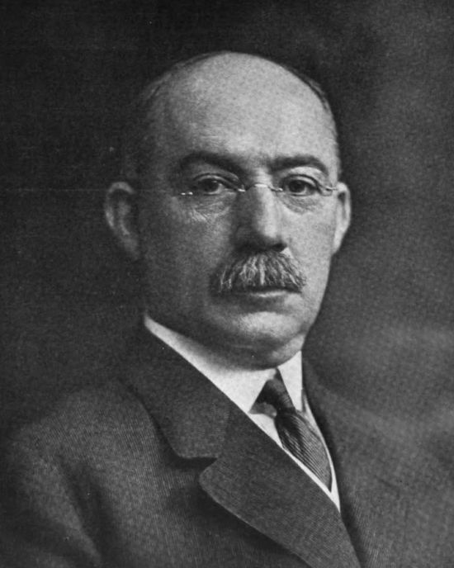
Gantt charts
Project timelines usually laid out a Gantt chart, named after the inventor, Henry Gantt (1861 to 1919).
Image source: https://en.wikipedia.org/wiki/Henry_Gantt#/media/File:Henry_L._Gantt.jpg

Slide 59
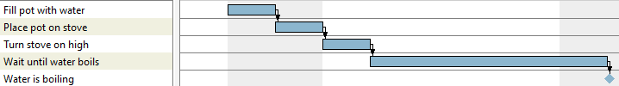
Gantt charts
Bar chart showing a project schedule.
Tasks listed vertically, horizontal axis is time.
Bars represent the duration of each task.
Example project: Boiling water
Most popular project planning software is Microsoft Project but it’s not free.
A good free alternative is GanttProject from https://www.ganttproject.biz/.

Slide 60
dependencies
Dependencies between tasks are represented by arrows between them.
Shown here: Finish-to-start dependencies.
No delay
Delay
Overlap

Slide 61
Dependencies
Start-to-start dependencies.
No delay
Delay
Negative Delay

Slide 62
dependencies
Start-to-finish dependencies.
No delay
Delay
Negative Delay

Slide 63
dependencies
Finish-to-finish dependencies.
No delay
Delay
Negative Delay

Slide 64
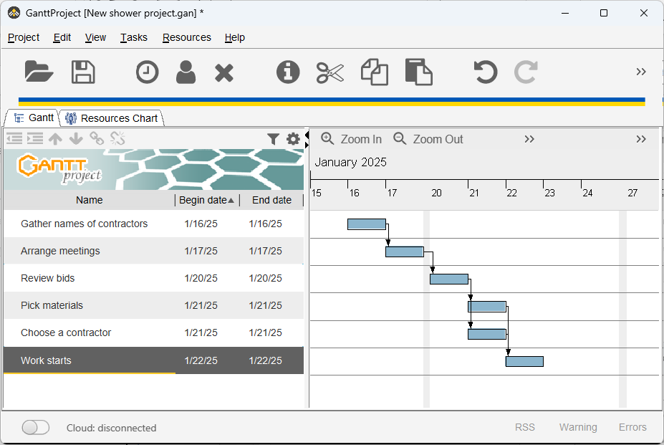

Slide 65
an exercise
You’ve been invited to a job interview in Mountain View, CA. They’ve given you several possible dates and asked that you make your own travel arrangements, which they will reimburse. Draw a sensible Gantt chart of the following activities.
Book a flight and a hotel.
Catch an Uber to the airport.
Decide what day is best.
Pack your bags.
To keep your chart simple and easy for us to grade, draw it simply as boxes and arrows with the one-word name of the activity inside each box.

Slide 66
Spoiler alert
The next page contains a solution.

Slide 67
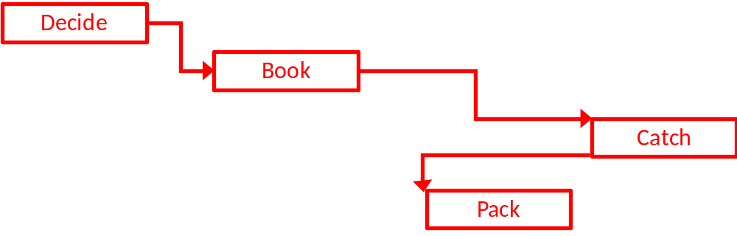
Did you get something like this?

